Slide 1
VLSI (Stick Diagram)

Slide 2
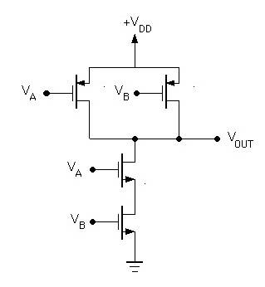
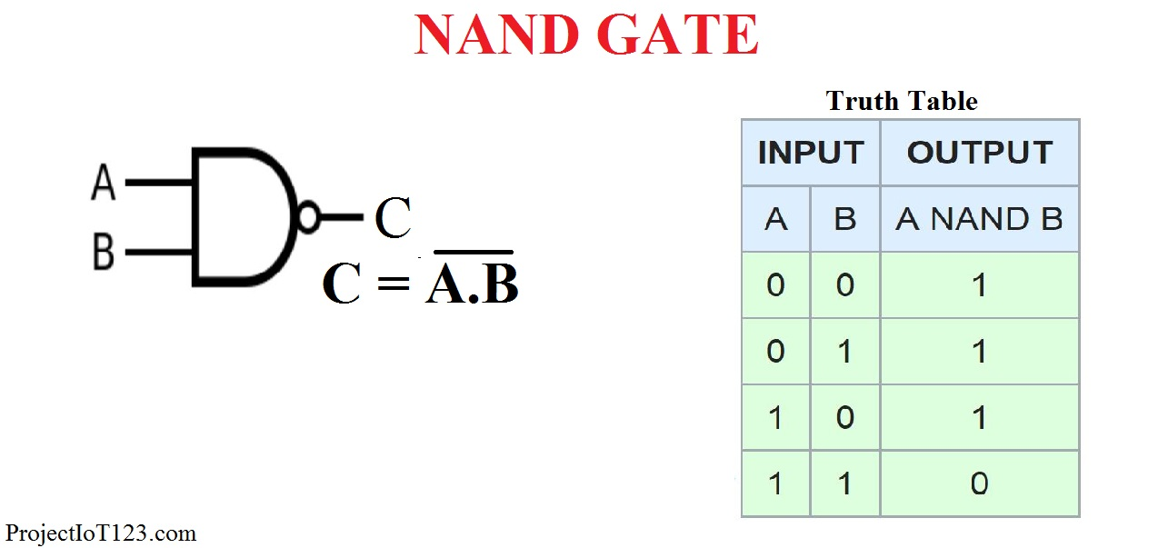
CMOS NAND gate
Va | Vb | Q1 | Q2 | Q3 | Q4 | Vout
0 | 0 | ON | ON | OFF | OFF | 1
0 | 1 | ON | OFF | OFF | ON | 1
1 | 0 | OFF | ON | ON | OFF | 1
1 | 1 | OFF | OFF | ON | ON | 0

Slide 3
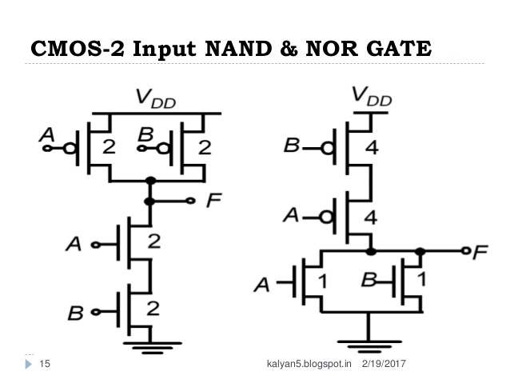
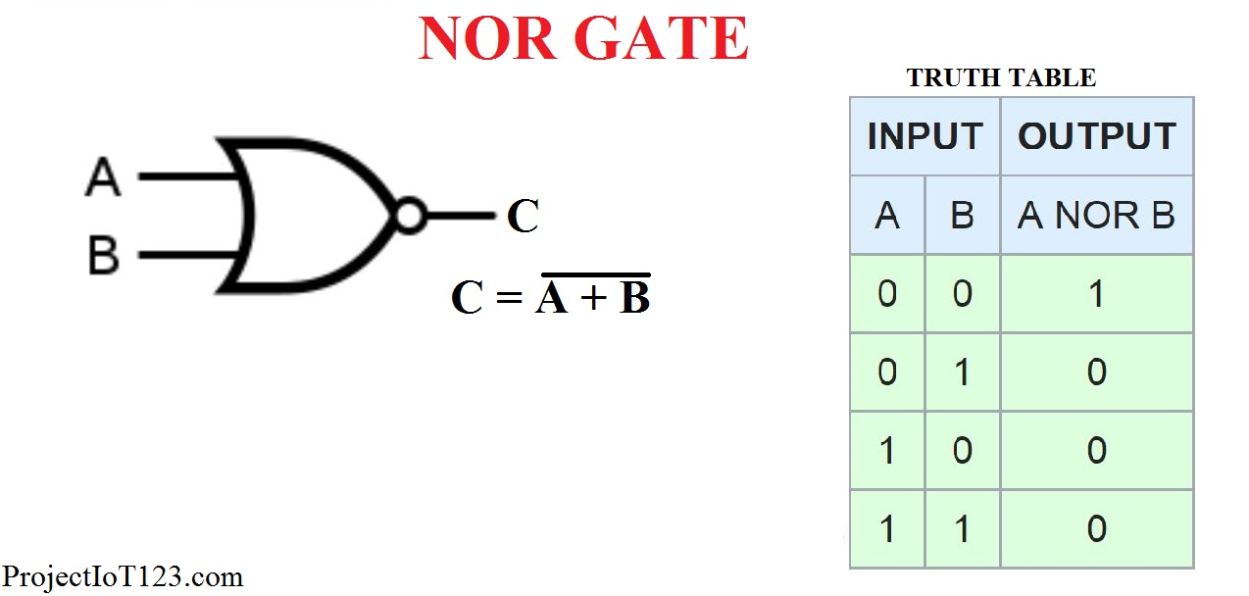
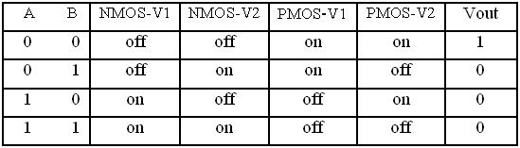
CMOS NOR gate?

Slide 4
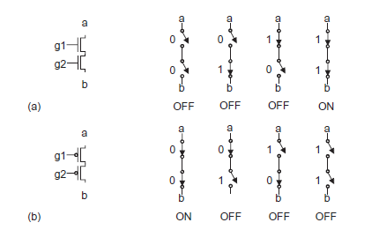
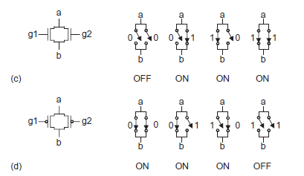
Behavior of MOS Transistor

Slide 5
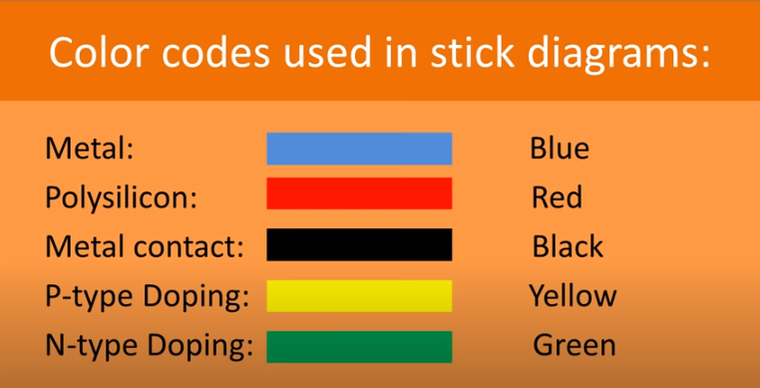
Color Code

Slide 6
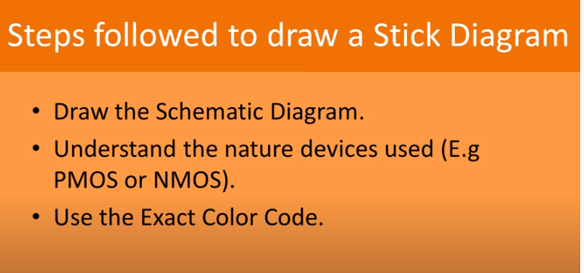
Stick Diagram

Slide 7
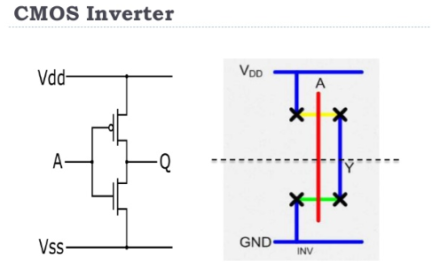
Stick Diagram
Stick diagrams are a means of capturing topography and layer information using simple diagrams.
Stick diagrams convey layer information through color codes (or monochrome encoding).

Slide 8
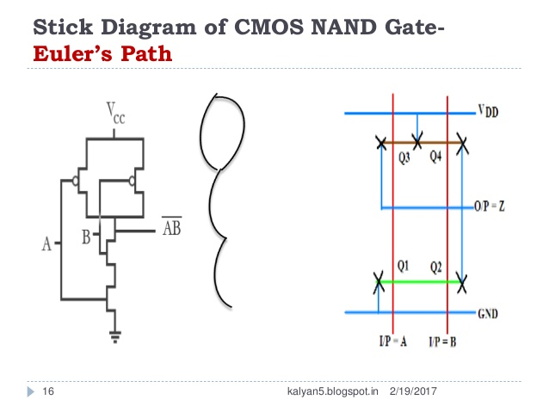
Stick Diagram

Slide 9
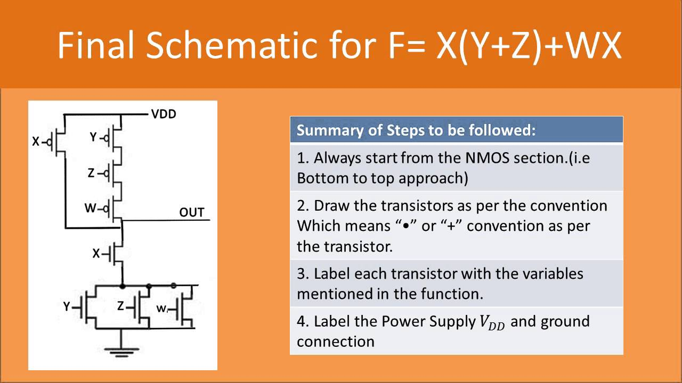
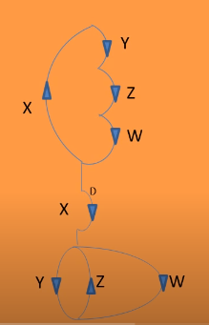
Expressions F=X(Y+Z)+WX

Slide 10
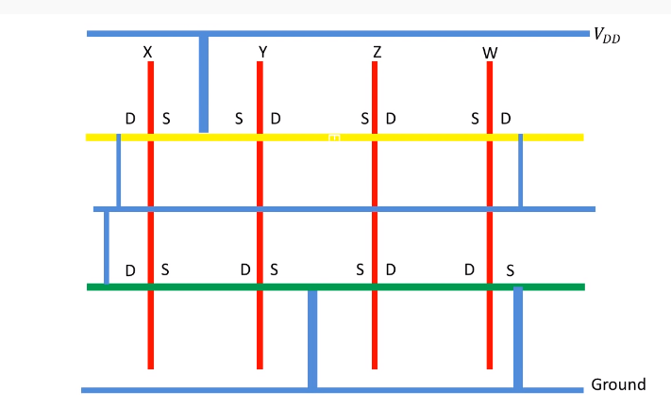
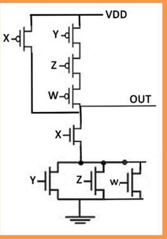
Stick Diagram

Slide 11
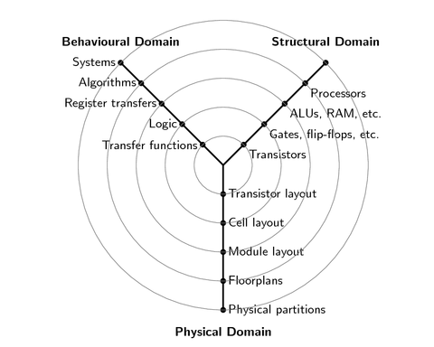
Gajski-Kuhn Y-chart
The Gajski-Kuhn Y-chart is a model which captures the considerations in designing semiconductor devices.
The three domains of the Gajski-Kuhn Y-chart are on radial axes.

Slide 12
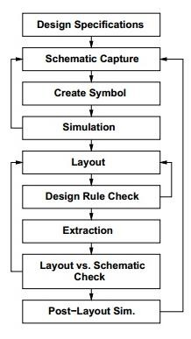
VLSI Design Flow
Specifications comes first, they describe abstractly, the functionality, interface, and the architecture of the digital IC circuit to be designed.
Behavioral description is then created to analyze the design in terms of functionality, performance, compliance to given standards, and other specifications.

